Slide 1
I Know Why the Caged Bird Sings
Carla Frias & Ivana Rizo Patrón

Slide 2
Chapter 9 Summary
Big Bailey visits Maya and Bailey in Stamps.
Children visit their mother in St. Louis.
Bailey and their father have a great relationship.
Maya and their father act as strangers.
The children, finally see their mother
Maya feels that: “a stranger just left her with another stranger.”
Notes:
carla

Slide 3
Chapter 10 Summary
Maya & Bailey live with Grandmother Vivian.
Mother’s brothers have city jobs and are considered mean and tough
Maya learns her nickname comes from Bailey calling her “Mya sister”.
6 months later, the children move with Vivian & Mr. Freeman.
Notes:
ivana
Maya & Bailey live with Grandmother Vivian.
They meet underground organized crime figures and learn that their Mother’s brothers have city jobs and are considered mean.
Maya learns her nickname comes from Bailey calling her “Mya sister”.
After 6 months, the children move with Vivian and her fat, old and insecure boyfriend, Mr. Freeman.

Slide 4
Chapter 11 Summary
Vivian studied to be a nurse, yet she is working in gambling parlor at night.
Maya begins to sleep in Mr. Freeman’s and Mother’s bed when her nightmares return.
Mr. Freeman sexually molests Maya and threatens to kill Bailey if she accuses him.
Mr. Freeman ignores Maya for weeks and then molests her again.
Maya feels lonely and rejected and begins to read.
Maya and Bailey begin to grow apart.
Notes:
carla

Slide 5
Chapter 12 Summary
Mr. Freeman sexual assaults Maya.
He threatens to kill Bailey if Maya tells him about it.
Mr. Freeman sends Maya to the library but Maya returns because of the intense pain in her legs.
Maya goes to bed and hides her panties, making Vivian think she has measles.
Vivian argues with Mr. Freeman; he moves out the next morning.
Bailey finds Maya’s bloody panties.
Notes:
ivana

Slide 6
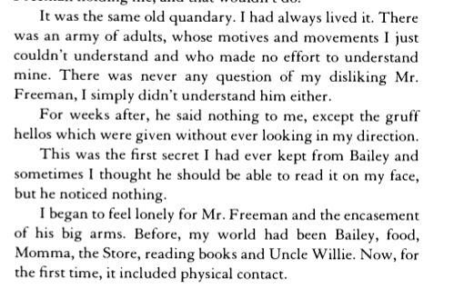
Extract
Pages 74 - 75

Slide 7
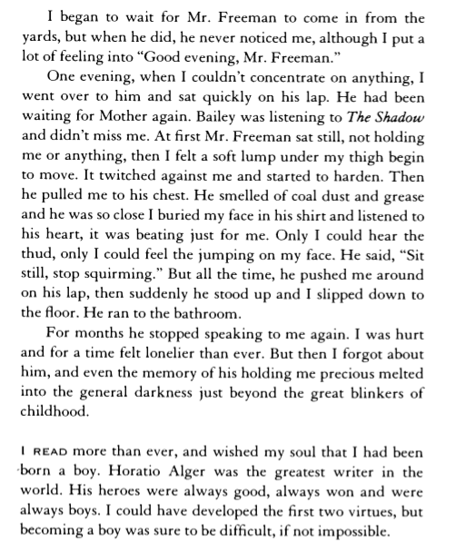
Extract
Pages 74 - 75

Slide 8
Context & Content
1936, St. Louis, Missouri
Racial segregation against African American’s
End of chapter 11
Mother Dear’s house
Mr. Freeman, molested Maya and does not speak to her for weeks. She feels lonely and rejected. Maya is molested again by Mr. Freeman.
Shows her reaction.
Notes:
ivana

Slide 9
Importance of Scene
Defines Maya and her actions to follow.
The reason why she did not speak for 5 years.
Maya was 8 years old; it help define her childhood and teenage years.
Notes:
carla

Slide 10
Purpose
To show what she went through and describe the effects it had on her.
To inspire girls in similar situations
“But then, I forgot about him…”
Show psychological effects of the absence of a father figure
“I went over to him and sat quickly on his lap.”
Notes:
ivana

Slide 11
Psychological Effects
Absence of her father
“Hungry for Love” → Male attention fill-in emptiness to their life
Prone to ‘sexually promiscuous behavior’
Notes:
Carla
http://library.wcsu.edu/dspace/bitstream/0/527/1/Final+Thesis.pdf
http://www.photius.com/feminocracy/facts_on_fatherless_kids.html

Slide 12
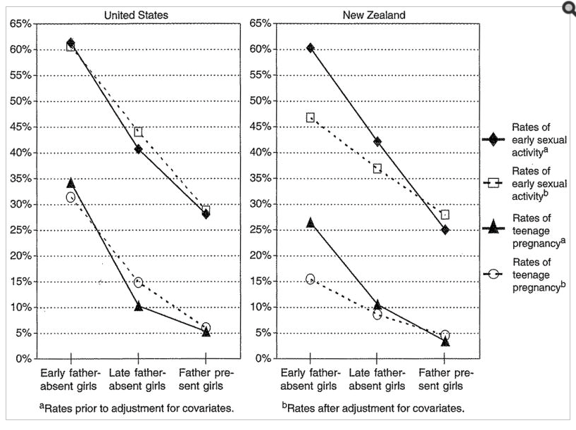
Notes:
carla

Slide 13
Audience
Her son Guy Johnson, who the book is dedicated too.
People interested in knowing about her life and about the time of segregation in the USA.
Teenage girls in similar situations.
Notes:
Ivana

Slide 14
Themes
Self acceptance and assurance
‘Need for love & attention’ Maya feels.
Discrimination against women
Notes:
carla

Slide 15
Stylistic Devices
Metaphor
“...and even the memory of his holding my precious melted into the general darkness.”
Symbolism
“...he was so close I buried my face in his shirt and listened to his heart, it was beating just for me”
Notes:
ivana

Slide 16
Onomatopoeia
“Only I had hear the thud….”
Imagery
“I began to feel lonely for Mr. Freeman and the encasement of his big arms.”
“At first, Mr. Freeman sat still, not holding me or anything, then I felt a soft lump under my thigh begin to move.”
Notes:
carla

Slide 17
Alliteration + Exaggeration
“There was an army of adults, whose motives and
movements I just couldn't understand...”
Allusion + Repetition
“Horatio Alger was the greatest writer in the world. His heroes were always good, always won and were always boys.
Notes:
ivana

Slide 18
Tone and Mood
Lonely
“I began to feel lonely for Mr. Freeman and the encasement of his big arms.”
“For months he stopped again speaking to me again. I was hurt and for a time felt lonelier than ever”
Desperate, Anxious
“I began to wait for Mr. Freeman to come in from the yards, but when he did, he never noticed me, although I put a lot of feeling into “Good evening, Mr. Freeman.”
“I thought he should be able to read it on my face, but he noticed nothing.”
Notes:
carla

Slide 19
Organization and Structure
Mr. Freeman: short sentences → strong and fast actions, anxious, jitter, negative memories.
“Then he pulled me to his chest” “He ran to the bathroom”
Maya: long sentences → mixed feelings, confusion, reflection.
“I began to feel lonely for Mr. Freeman and the encasement of his big arms”
Small paragraphs: a happening or a reflection done by Maya.
Notes:
ivana

Slide 20
Title-Scene Connection
Maya is a bird waiting to fly
Trapped in her past, her culture, her reality
Sings to seek something greater → love, brotherhood, books, independance, social equality
Scene → symbolism → greater view of the big world (new places, new adventure)
Notes:
-Carla

Slide 21
Works Cited
Ellis, Bruce J., John E. Bates, Kenneth A. Dodge, David M. Fergusson, L. John Horwood, Gregory S. Pettit, and Lianne Woodward. "Does Father Absence Place Daughters at Special Risk for Early Sexual Activity and Teenage Pregnancy?" Child Development. U.S. National Library of Medicine, n.d. Web. 6 Mar. 2015. <http://www.ncbi.nlm.nih.gov/pmc/articles/PMC2764264/>.
"Facts on Fatherless Kids." Dads4Kids. N.p., n.d. Web. 6 Mar. 2015. <http://www.photius.com/feminocracy/facts_on_fatherless_kids.html>.
I Know Why The Caged Bird Sings Book Cover. Digital image. 60 Second Recap. N.p., n.d. Web. 8 Mar. 2015. <http://www.60secondrecap.com/wp-content/uploads/2013/05/i-know-why-the-caged-bird-sings1.jpg>.

