Slide 1
Imitation
Carla Frías, Alejandro Muñiz & Guillermo Cabrera

Slide 2
Chimamanda Ngozi Adichie
Nigerian Novelist
Attended the University of Nsukka (Southeastern Nigeria)
Her father - professor of statistics
Her mother - university first female registrar
→ Opportunities
Reached her dreams:
Medicine (University of Nigeria)
Creative writing (Johns Hopkins)
Arts degree (Yale University)
Notes:
Carla

Slide 3
Imitation
Belongs to the collection “The thing around your neck”
Published in 2009
MacArthur Fellowship Foundation
“celebrates and inspires the creative potential of individuals through no-string-attached-individuals.”
Notes:
Alejandro

Slide 4
Setting/Cultural context
Africans living in America
Job offers
Chance to live a “better” life
Higher quality education
Cherrywood Lane in a Philadelphia suburb
Pre-fixed stereotypical names:
“Rich Nigerian Men Who Sent Their Wives to America to Have Their Babies league.”
Recognition in Africa vs. America
“Because America does not recognize Big Men. Nobody says ‘Sir! Sir’ to them in America”
Notes:
Alejandro

Slide 5
Imitation - Content
Nigerian woman who lives in America with her 2 kids
Her husband is in Nigeria - successful business man “Big Man”
Phone call: Her husband is cheating on her
Starts to worry - over think
Asks Nkem (maid)
Asks the new houseboy
Tells him to go back to Lagos, Nigeria
Notes:
Guillermo

Slide 6
Sequence
How the story is opened
Goes right into the problem
Single Plot/Conflict
Husbands girlfriend
Focus
Nkems isolation, doubt
Sequencing of time
Chronological
Notes:
Guillermo

Slide 7
Beginning vs End
Beginning
“Nkem is staring at the bulging, slanted eyes of the Benin mask on the living room mantel as she learned about her husband’s girlfriend.”
Emotional - angry
Symbolism: cultural traditions
What has become common/normal
End
“She gently turns him around and continues to soap his back. There is nothing left to talk about. Nkem knows; its done”
Contradictory ideas
Undefined emotions
Symbolism: wash
Gets control
Notes:
Carla

Slide 8
Imitation - Importance of the title
Title: Imitation: to stimulate or copy
The American culture & its customs
To pretend to be someone you are not
Using imation as a tool to preserve their culture
Physical aspects (hair, texturizer)
Traditions: Benin’s Pendant mask
Notes:
Carla

Slide 9
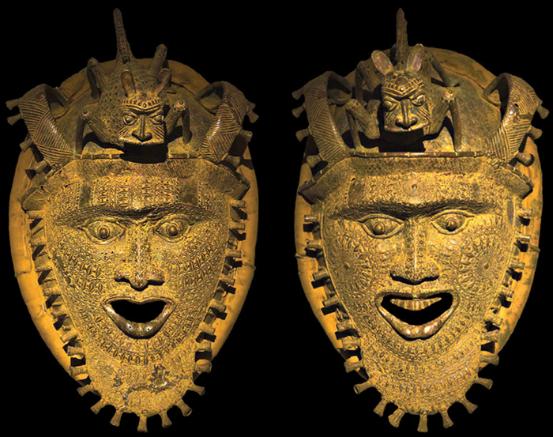
Benin's Pendant Mask
- Mask worn around the neck/waist
- Used for royal ceremonies - protecting him from the evil
- British stole the original masks in the late 1800s (Punitive Expedition)
“...it is cold, heavy, lifeless.”
“He makes them seem breathing, warm”
Notes:
Carla

Slide 10
Characters
Nkem
Representation of a women in married relationship
Lives to raise a family, American dream
Homesick, Isolation
Obiora
Important businessman
Art collector and wealthy man
Lives in Nigeria while his family in the US
Notes:
Alejandro

Slide 11
Characters
Amaechi
Servant or maid of the house
Serves as adviser for Nkem
Becomes Nkem’s best friend
“You will forgive him, Madam. Men are like that”
Ijemamaka
Nkem’s closest African friend
Jealous of Nkem?
“This is what happens when you marry a rich man”
Notes:
Guillermo

Slide 12
Stylistic Devices
Third Person narrator:
“He always marveled at what the children could do, what they like and didn’t like, although they were all things she had told him on the phone.”
Metaphors:
“Smelled fresh, like green tea” (pg. 24)
“Lives Obiora often called “plastic”” (pg. 25)
“Mermaid eyes” (pg. 28)
“Through the compliment gave her another set of eyes” (pg. 28)
Anaphoras:
“When she will wake up at night to hear snoring beside her; when she will see another used towel in the bathroom” (pg.30)
“Nobody says “Sir! Sir!” to the in America. Nobody rushes to dust their seats before they sit down.” (Pg. 29)
Notes:
Alejandro

Slide 13
Theme? → building relations/connections
Isolation lead to undesire thoughts
Desire to be socially accepted
Wealth vs. Happiness
Notes:
carla

Slide 14
Message
Wealth does not reflect happiness
Always stay true to yourself
Notes:
Guillermo

Slide 15
Universal Human Context
Gender inequality
“You will forgive him, mada. Men are like that.”
“She liked it when he said we”
“Our men like to keep us here, she had told Nkem”
“We are moving back at the end of the school year.”
“I want to know when a new houseboy is hired in my house.”
“There is nothing left to talk about”
Oppressed by social standards
Believes that infidelity is common/normal
Takes a stand
Notes:
Carla F

Slide 16
Differences in Community
African vs America
Standards of life
“She had never imagined that her children would go to school, sit side by side with white children whose parents owned mansions on lonely hills..”
“She remembers the shy, eager sixteen-year-old Obiora brought to America, who for months remained fascinated by the dishwasher”
“Instead, her momer improvised food. She remembered how her mother plucked plant leaves that nobody else made”
Notes:
Guillermo

Slide 17
Universal Human Context
Social divisions
American dream
Wealthy life
US > Nigeria
Opportunities
“They get us house girls from Nigeria who we don’t have to pay any outrageous American wages”
“She goes to a Pilates class twice a week in Philadelphia with her neighbors; she bakes cookies for her children’s classes..”
“Nkem watched Amaechi slice potatoes…”
Notes:
Carla

Slide 18
Importance of the Story
Portrays the life of Nigerians in America (social cycle)
One story?
Notes:
Alejandro

